Slide 1
UNITED NATIONS GLOBAL GEODETIC
CENTRE OF EXCELLENCE
MODERNISING GEOSPATIAL REFERENCE SYSTEM
CAPACITY DEVELOPMENT WORKSHOP
How to undertake a national geodetic adjustment?
Nicholas Brown
Head of Office, UN-GGCE
Day 2, Session 2 [2_2_1]
HOW
Acknowledgements: Phil Collier (AUS); Nic Donnelly (NZ); Roger Fraser (AUS); Craig Harrison (AUS); Anna Riddell (AUS).

Slide 2
When to consider geodetic adjustments
Datum not aligned with current version of ITRF
Distortion in datum due to geophysical reasons
Increase in accuracy of datum is needed for emerging technologies
GNSS CORS network has been densified (improved resolution)
STRONGER.
TOGETHER.
Notes:
And now you see that some points have a coordinates in both the regional reference frame (or ITRF) and the national geodetic datums – points with red cross and blue dot.

Slide 3
How to aligning NGD with ITRF
ITRF2020
Choose an ITRF realisation and epoch to align to (e.g. ITRF2020@2024)
Include the GNSS CORS from your country in the regional reference frame (e.g EUREF)
Even if the GNSS CORS are not in the IGS network, they will be linked to the ITRF through the regional reference frame,
The positions from the GNSS CORS in your country which are analysed in the regional reference frame are used as the constraint in the national adjustment.
Regional Reference Frame
National Geodetic Datum
STRONGER.
TOGETHER.

Slide 4
How to align NGD with ITRF
National GNSS CORS
GNSS CORS included in International or regional reference frame
STRONGER.
TOGETHER.
Notes:
And now you see that some points have a coordinates in both the regional reference frame (or ITRF) and the national geodetic datums – points with red cross and blue dot.

Slide 5
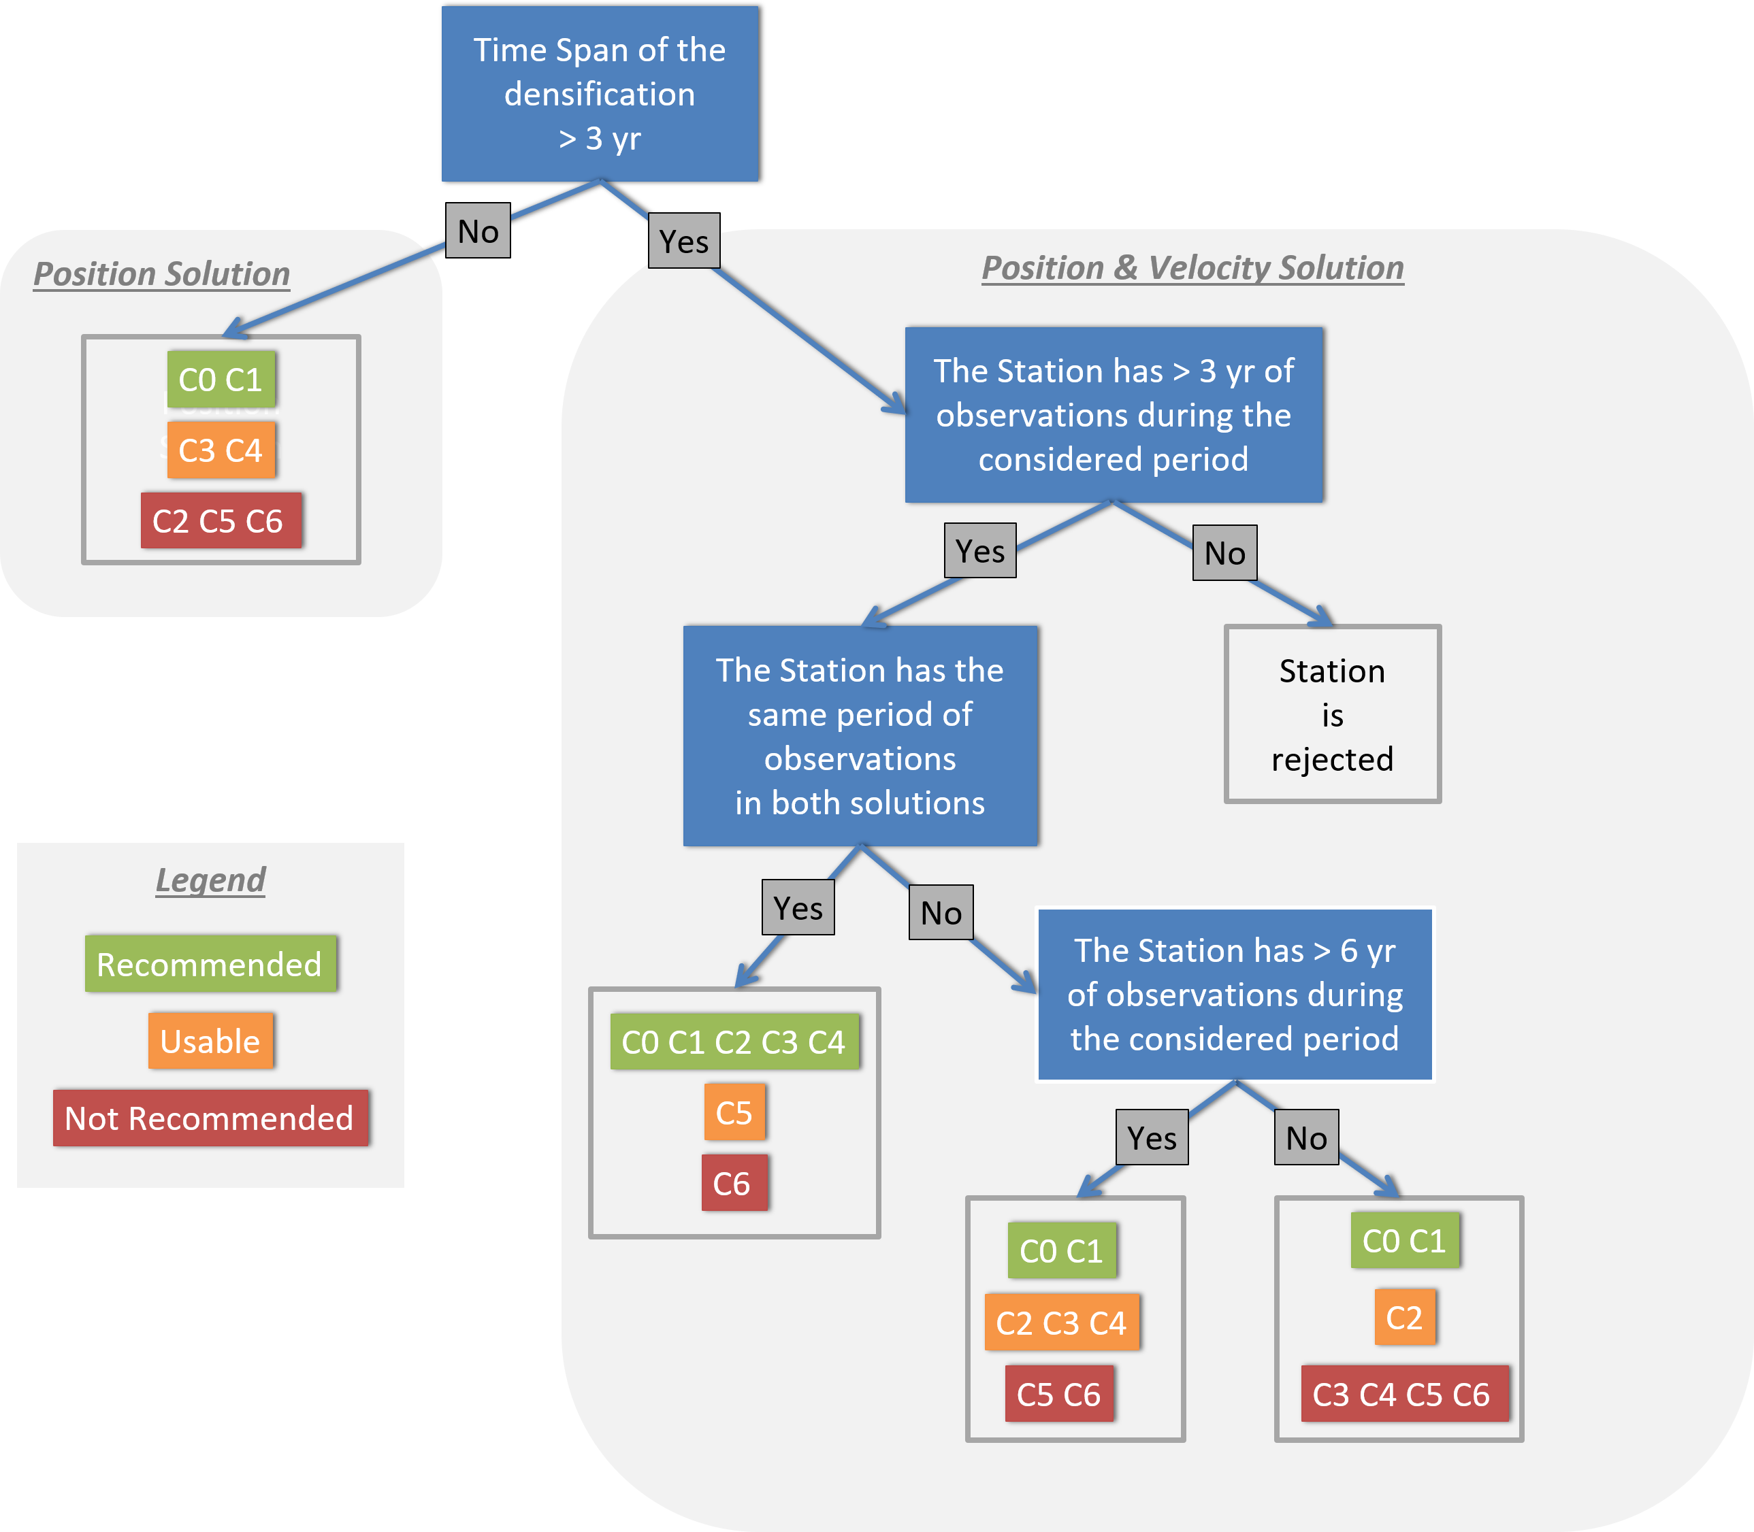
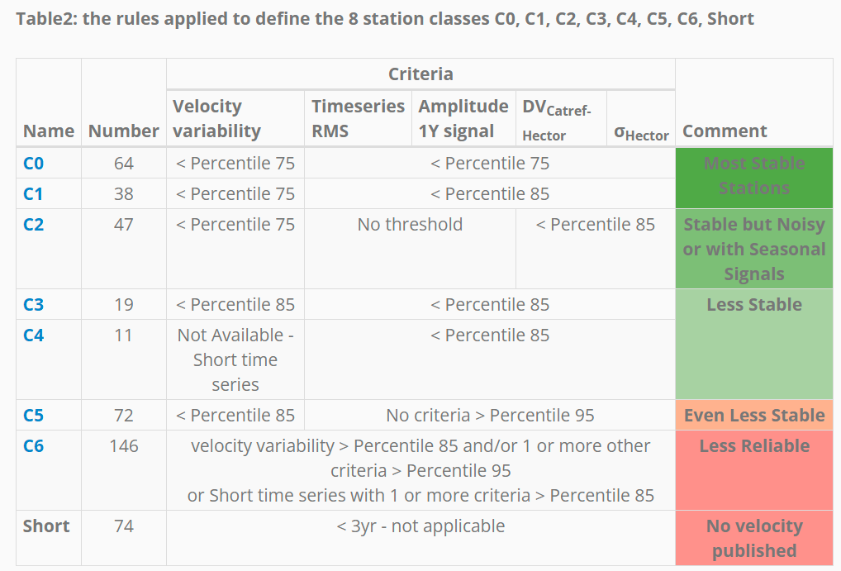
Site selection process
STRONGER.
TOGETHER.
https://epncb.oma.be/_productsservices/ReferenceFrame/Tool.php
Notes:
And now you see that some points have a coordinates in both the regional reference frame (or ITRF) and the national geodetic datums – points with red cross and blue dot.

Slide 6
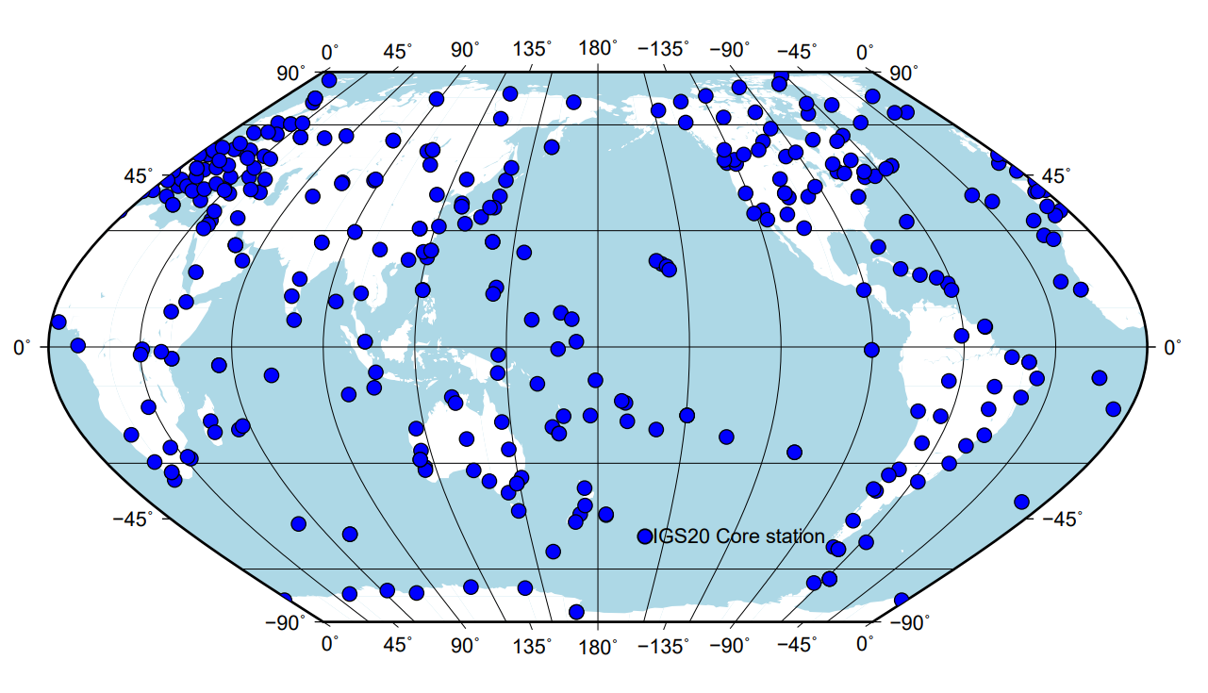
IGS20 sites
STRONGER.
TOGETHER.

Slide 7
Regional Reference Frame (e.g. APREF)
Continuously estimated from:
Weekly solutions combined from daily GNSS analysis
Aligned to IGb14
Cumulative solution combines weekly solutions from 1994
Full variance matrix
Provides datum constraint for jurisdiction and national adjustments
Densification of ITRF in the Asia Pacific region:
726 GNSS CORS total;
488 on AU plate.
Only 15 in ITRF2014

Slide 8
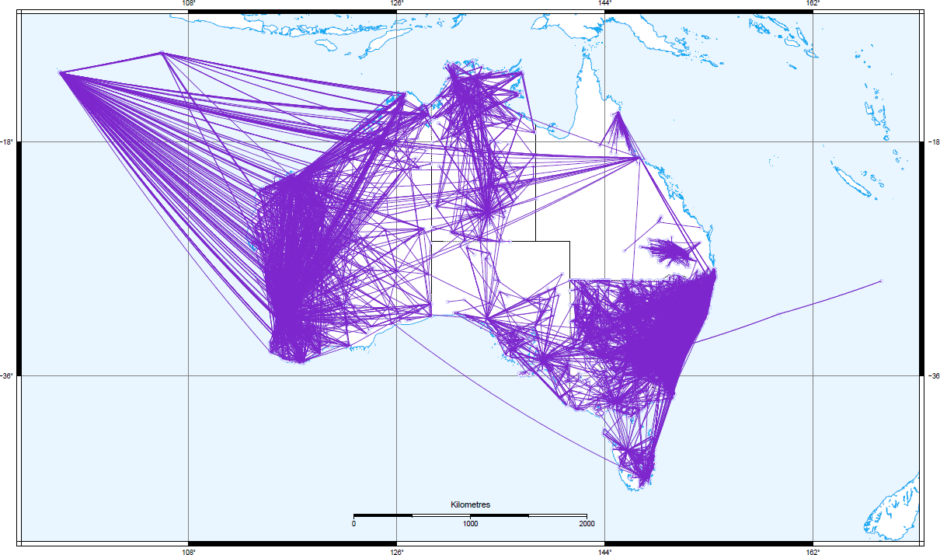
Campaign archive
Network backbone
6+ hour GNSS observations
Processed by GA
6,092 stations with 11,578 baselines in 3,206 clusters

Slide 9
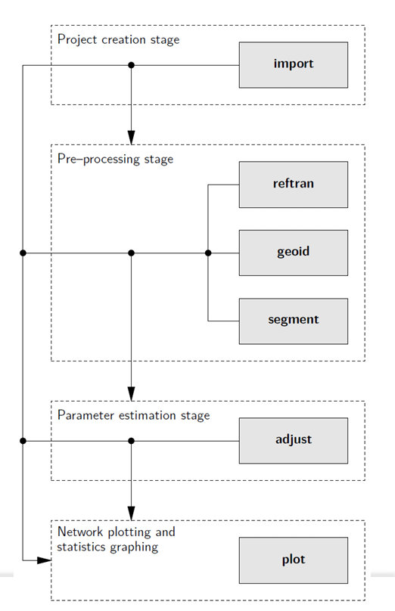
Fully automated adjustment approach
Import all data
SINEX, GNSS baselines, terrestrial measurements, levelling
Align stations and measurements to an epoch (e.g. 2020)
Datum/frame transformation (ITRF2000,2005,2008,2014)
Apply plate motion model if no direct parameters are available
Apply geoid model to convert orthometric data to ellipsoidal
(Gravity) deflections of the vertical
Ellipsoid-geoid separations
Automatic network segmentation
Parallel or sequential phased adjustment
Export uncertainties
Notes:
To generate rigorous coordinates and uncertainties each month from a continental-sized geodetic network subject to continual updates in the APREF,
NGCA and JADJ datasets, a high-performance least-squares adjustment application known as DynAdjust is used. Without the highly efficient, automated, and flexible approach that DynAdjust provides for the national adjustment process, the NADJ would not be feasible. DynAdjust was developed by Fraser et al. (2022) and draws upon over 30 years of research and development in least-squares adjustment at the former Department of Geomatics, University of Melbourne. DynAdjust uses Tienstra’s (1956) phased least-squares adjustment technique, which permits a network to be divided into smaller sub-networks (or blocks) that can be adjusted either sequentially or in parallel in a completely rigorous way (Fraser et al. 2023). Dividing a network into blocks affords significant performance gains and minimises the computational limits that usually restrict the size of a network that can feasibly be adjusted. DynAdjust also provides a capability to automatically segment the entire network into blocks using a highly efficient and flexible algorithm. This capability permits the automatic re-segmentation of the JADJ and NADJ networks upon the introduction of new GNSS or terrestrial measurements. The advantages of this capability are that the adjustment of the NADJ (1) is not restricted by a fixed block hierarchy or state-based structure; (2) is able to adapt to continual station and measurement changes across the continent; and (3)produces rigorous coordinates and positional uncertainty for all stations across the net-work, as well as the computation of relative uncertainty between any nominated stations. The Australian geodetic network consists of roughly 2.4 million measurements and330,000 stations. Given its size, the NADJ is run on a compute-optimised Amazon Web Service (AWS) instance having 96 virtual cores, and 196 GiB of RAM. DynAdjust can operate in multi-threaded (or fully parallelised) mode, but to do so requires almost 3TiB of RAM. Therefore, the NADJ is run in a staged, sequential phased adjustment mode, which makes use of hard drive space to minimise the amount of RAM needed. In thismode, a single iteration of the national adjustment takes 3 hours and 20 minutes, and the adjustment requires 3 iterations to converge.

Slide 10
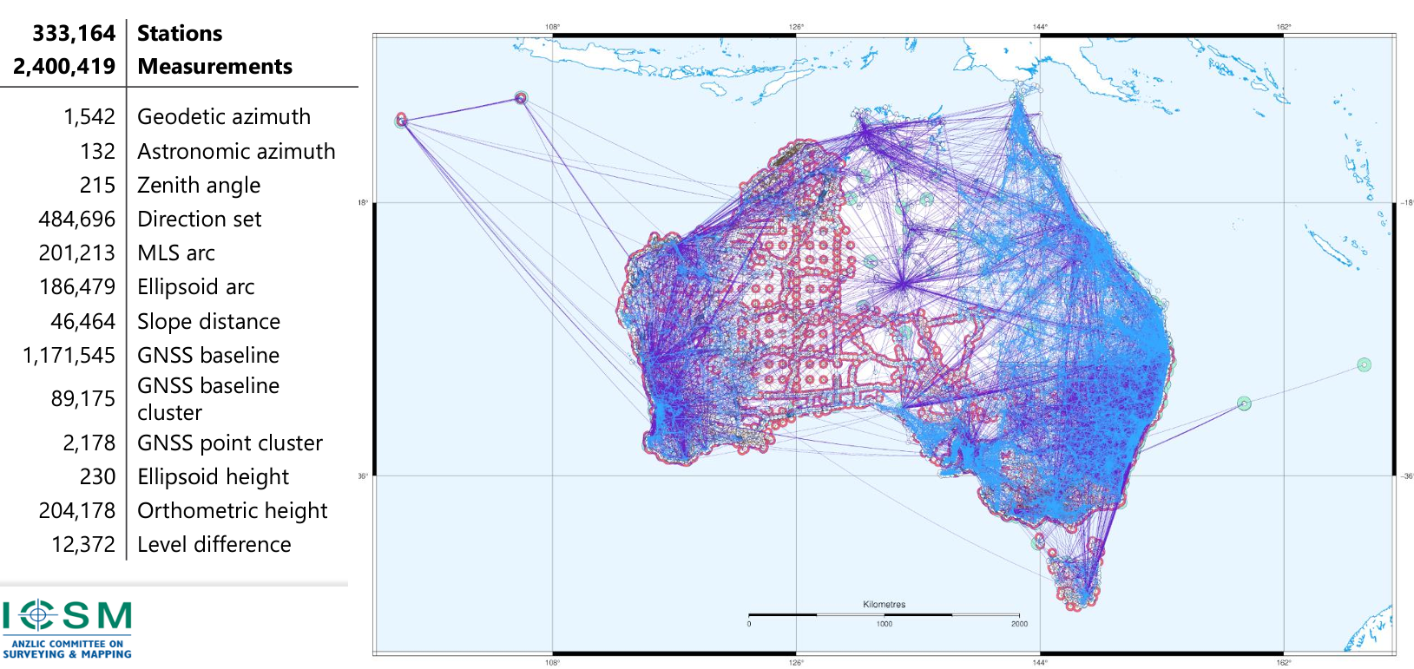
National adjustment

Slide 11
DynAdjust

Slide 12
Resources
GNSS analysis
BERNESE – network GNSS analysis
AUSPOS – GPS site analysis https://www.ga.gov.au/scientific-topics/positioning-navigation/geodesy/auspos
OPUS – GNSS site analysis https://geodesy.noaa.gov/OPUS/
CATREF – combination software
Geodetic Adjustment
DynAdjust (https://github.com/icsm-au/DynAdjust)
Least Squares training presentation
Full presentation – https://www.youtube.com/watch?v=T5YB_1Jpjp0 (1hr 42 mins)
Chapter 1 – What is Least Squares and why are we using it in DCM? https://youtu.be/0YkjHsVgGMk (26 mins)
Chapter 2 – Why do we iterate? https://youtu.be/_iFg3Ho_cRI (18 mins)
Chapter 3 – Weighting Observations https://youtu.be/2yQCWblrQGs (10 mins)
Chapter 4 – Constraints https://youtu.be/WcwKv-vWUtk (7 mins)
DynAdjust Q&A https://youtu.be/WZN38NrPBeY
STRONGER.
TOGETHER.

Slide 13
Template
STRONGER.
TOGETHER.

Slide 14
How to align NGD with ITRF
GNSS CORS
GNSS CORS included in regional reference frame
STRONGER.
TOGETHER.
Notes:
And now you see that some points have a coordinates in both the regional reference frame (or ITRF) and the national geodetic datums – points with red cross and blue dot.

Slide 15
What is a geodetic adjustment?
What are they?
A geodetic adjustment is a mathematical process used in to ensure that a network of measurements is as accurate as possible.
It involves correcting and optimizing observations, such as angles, distances, and coordinates, to minimize errors and provide the best possible fit for a geodetic model or reference framework.
Types of Geodetic Adjustments
Local Adjustment: Applied to small-scale networks, like a local land survey.
Regional/National Adjustment: Adjusts measurements across larger areas, such as a country, to align with a specific geodetic datum.
Global Adjustment: For datasets like those from satellite observations, ensuring consistency across a global reference frame.
STRONGER.
TOGETHER.

Slide 16
What is a geodetic adjustment?
Key Elements of Geodetic Adjustment
Observations and Measurements: These can include GNSS data, satellite measurements, leveling data, and traditional surveying observations like distances and angles.
Mathematical Model: A geodetic adjustment relies on mathematical models, such as least squares adjustment, to minimize discrepancies between observations and theoretical values.
Error Minimization: It accounts for measurement errors (instrumental, observational, or environmental) and distributes these errors across the network in a statistically optimal way.
Reference Frames: Adjustments often aim to align the data with a specific geodetic reference system, like WGS84, NAD83, or ETRS89, ensuring consistency across datasets.
STRONGER.
TOGETHER.

Slide 17
What is “least squares”?
Measured values
An optimal estimation technique dealing with:
Redundant observations
Non-linear observation equations
It gives a unique solution from infinite possibilities
Minimises the weighted sum of the squared residuals
Hence the name “least squares”
It is the best (most statistically likely) solution
True length (unknown)
STRONGER.
TOGETHER.

Slide 18
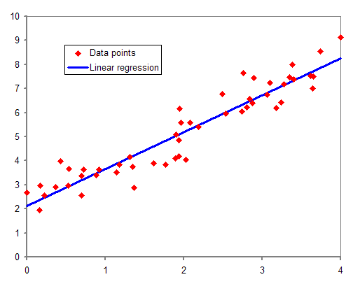
What is “least squares”
Example:
3+ observations by only 2 unknowns!
First-degree polynomial of the form: y = a x + b + e
is given by:
$\left[\begin{matrix}y_{1} \\ y_{2} \\ y_{3}\end{matrix}\right] = \left[\begin{matrix}x_{1} 1 \\ x_{2} 1 \\ x_{3} 1\end{matrix}\right] × \left[\begin{matrix}a \\ b\end{matrix}\right]$ + $\left[\begin{matrix}e_{1} \\ e_{2} \\ e_{3}\end{matrix}\right]$
Linear Regression
$$\sum_{i=1}^{3}{{e_{i}^{2}=min}^{}}$$
observations
design matrix
unknown parameters
error
Design matrix: Organizes the values of explanatory variables (independent variables) for multiple observations in a structured way.
Last square condition
The resulting parameters are describing a best fitted line to the observations.

Slide 19
Why geodetic adjustments are needed
Measured values
Complex, massive, estimation problem
Combination of diverse data types
Data quality varies greatly (e.g. with survey date)
Goal is to improve & quantify coordinate accuracy
Least squares approach provides:
A statistically optimal combination of data
Individual weighting of observations
Sophisticated debugging and validation of results
Minimal impact on the original observations
Reliable accuracy estimates of final coordinates
True length (unknown)
STRONGER.
TOGETHER.

Slide 20
Weighting observations
Measured values
It’s a fact:
Not all observations are of the same type
Not all observations are of the same precision
Most precise observations should have the most influence
Assigning an appropriate a priori standard deviation to each observation is the way to achieve this
Standard deviations are applied through weighting matrix in least squares
True length (unknown)
STRONGER.
TOGETHER.

Slide 21
Constraining stations
Link the adjustment to the national geodetic datum
Limit propagation of measurement errors
Improve precision of adjusted coordinates
Will be sourced from the national geodetic adjustment
Will be constrained by variances from the national adjustment
STRONGER.
TOGETHER.

Slide 22
Levelling Example
Start and end point are the same - closed circle.
Therefore, the sum of height differences is zero!
F
A
Measurements:
∆_{AB} = 2.45
∆_{BC} = -1.10
∆_{CD} = 0.55
∆_{DE} = 3.80
∆_{EF} = -4.10
∆_{FA} = -1.30
Inconsistencies:
B
∑ ∆ = 0
E
e = ∑ ∆
= 0.3
Error distribution:
∆_{AB} = 2.45 + 0.05
∆_{BC} = -1.10 + 0.05
∆_{CD} = 0.55 + 0.05
∆_{DE} = 3.80 + 0.05
∆_{EF} = -4.10 + 0.05
∆_{FA} = -1.30 + 0.05
D
C
e_{i} = 0.3 / 6
= 0.05
∑ ∆ = 0

Slide 23
3D Example
2. Regional Reference Frame
1. ITRF
3. Campaign
measurements
www.sli.do #AGRS

